Slide 1

STRING EDITING USING DYNAMIC PROGRAMMING
UNDER THE GUIDANCE OF
DEEPTHI KALAVALA MAM

Slide 2
TEAM MEMBERS
2010030410 – L.VAMSI KRISHNA 2010030383 – V.ABHIRAM
2010039004 – T.SAINATH REDDY 2010039004 – MITESH CHANDRA

Slide 3
abstract
The edit-distance between two strings is the smallest number of operations required to transform one string into the other. The edit-distance problem for two languages is to ﬁnd a pair of strings, each of which is from diﬀerent language, with the minimum edit-distance. We consider the edit-distance problem for a regular language and a context-free language and present an eﬃcient algorithm that ﬁnds an optimal alignment of two strings, each of which is from diﬀerent language. More-over, we design a faster algorithm for the edit-distance problem that only ﬁnds the minimum number of operations of the optimal alignment

Slide 4
PROBLEM STATEMENT
Given two strings str1 and str2, and the task is to find minimum number operations required to convert string str1 into str2.
Input – Output Data for the Algorithm
Str_1 : This contains the first string.
Str_2 : This contains the second string.
N : This contains the size of the first string.
M : This contains the size of the second string.
Solution : This is used to store the number of operations required.

Slide 5
Edit Distance | Dynamic Programming
The Edit distance is a problem to measure how much two strings are different from one another by counting the minimum number of operations required to convert one string into the other. Edit distance problem can be solved by many different approaches . But the most efficient approach to solve the Edit distance problem is Dynamic programming approach which takes the O(N * M) time complexity, where N and M are sizes of the strings.
Edit distance has different definitions which uses different sets of string operations. Levenshtein distance operations is the basic set of operations which is used in Edit distance Problem. Operation allowed are:
Delete any character from the string.
Replace any character with any other
Add any character into any part of the string.

Slide 6
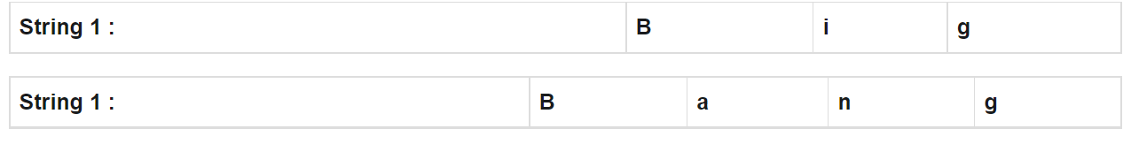
Example of the edit distance
Input and Output of the Example
Given two strings str1 = “Big” and str2 = “Bang” of size of N = 3 and N = 3 respectively, and the task is to find minimum number operations required to convert string str1 into str2.
Solution of the Edit Distance Problem Example
Solution of the above example using the Dynamic programming approach. Given data are :

Slide 7
background
This algorithm is so commonly used for Microsoft Outlook or Microsoft Word Spell Checking systems and Google. So thanks Vladimir Levenshtein for this algorithm. I will not try to explain the algorithm's details to you. The purpose of this article is for you to follow steps and see the flow chart of algorithm easily.

Slide 8
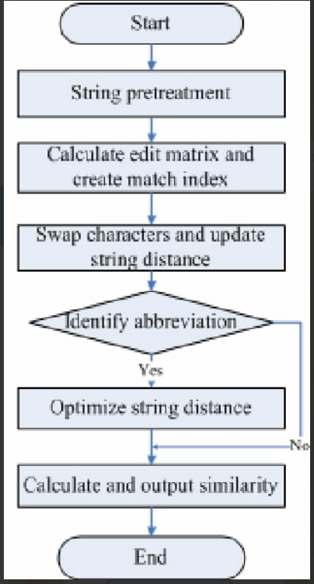
flowchart

Slide 9
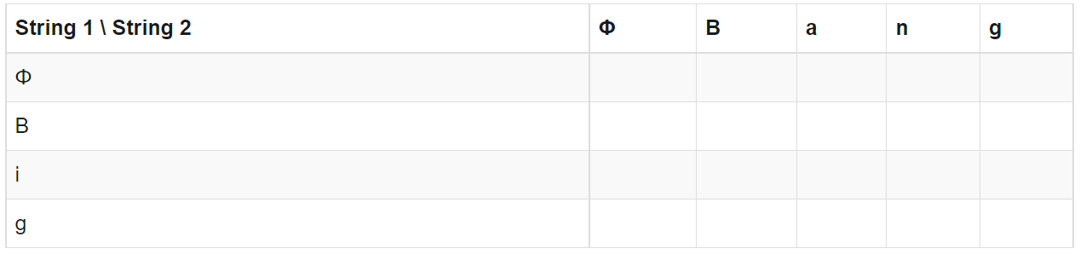
procedure
1.Create a empty table where First column represents the String 1 and First Row represents the String 2 with additional Value( empty value) in both.
2.Let us start filling the table untill one of the string is empty. We will compare “Big” to Φ and then “Bang” to Φ.
To convert Φ to Φ, we need no operation so value is 0.
To convert B to Φ, we need 1 operation of modify, so value is 1.
To convert i to Φ, we need 2 operation of modify and insert, so value is 2.
for g to Φ, value is 3.
Similarly for Bang, values will be 0, 1, 2, 3, 4.

Slide 10
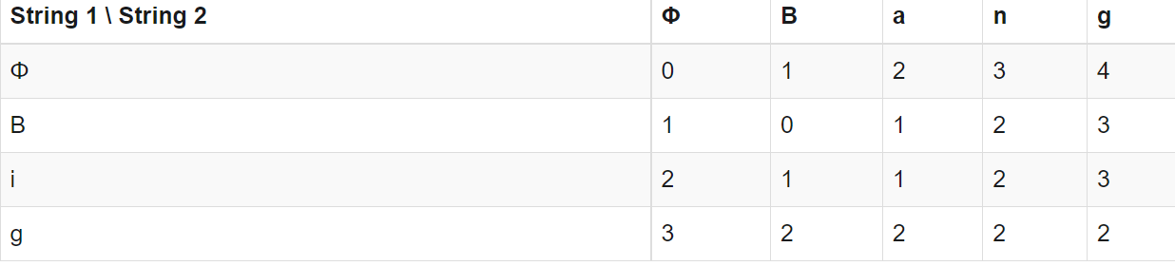
3.Now check the each character of String 1 with String 2. And update the table according to approach.
If str_1[i-1] == str_2[j-1]
Table [I , j] = table[i-1 , j-1]
Else:
Table [I , j] = 1+min(table[i-1] , [j-1] , table [i] [j-1])
6.Return Table[-1][-1] for the answer.

Slide 11
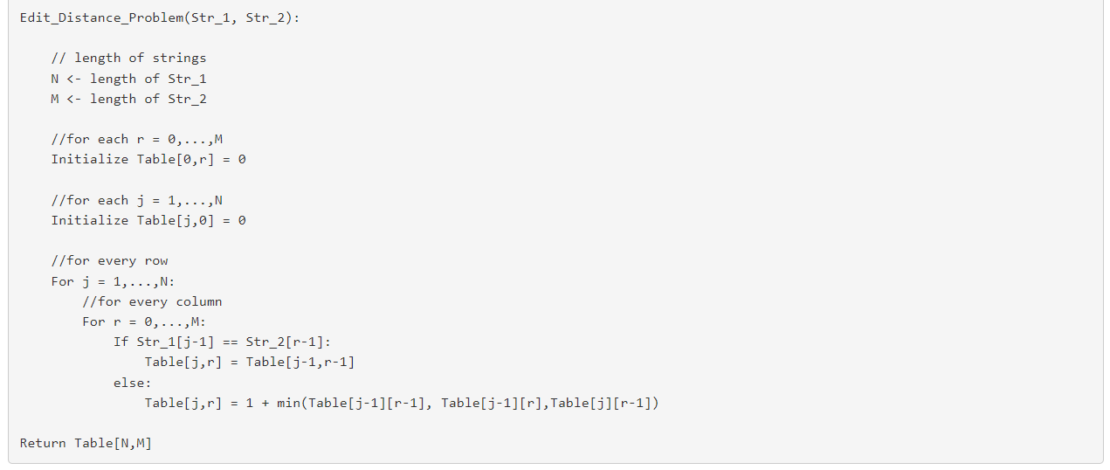
algorithm for edit distance
Here’s Pseudocode for solving the Edit Distance Problem using Dynamic programming.

Slide 12
implementation
# Python program for edit distance problem using
# Dynamic Programming Approach
# Create a table to store results of subproblems
def table():
return [[0 for i in range(M + 1)] for j in range(N + 1)]
# function to find minimum number operations
#required to convert string Str_1 into Str_2.
def Edit_Distance_Problem(Str_1, Str_2, N, M):
# Fill d[][] in bottom up manner
for i in range(N + 1):
for j in range(M + 1):
if j == 0:
Table[i][j] = i
elif i == 0:
Table[i][j] = j
elif Str_1[i-1] == Str_2[j-1]:
Table[i][j] = Table[i-1][j-1]
else:
Table[i][j] = 1 + min(Table[i-1][j-1], Table[i-1][j],Table[i][j-1])
# returning the result
Return table[n][m]

Slide 13
# Driver program
# Given two strings
Str_1 = "Big"
Str_2 = "Bang"
# Sizes of the strings
N = len(Str_1)
M = len(Str_2)
# create the Table
Table = table()
# Function calling
Solution = Edit_Distance_Problem(Str_1, Str_2, N, M)
# printing the solution
print(Solution)
So , this this the program.

Slide 14
hardware and software used
Hardware :
We have used DELL laptop which includes 8GB of RAM and 128GB of STORAGE.
Which is also x64 PROCESSOR.
Software:
PYTHON3 as PROGRAMMING LANGUAGE and VSCODE software for executing the program.

Slide 15
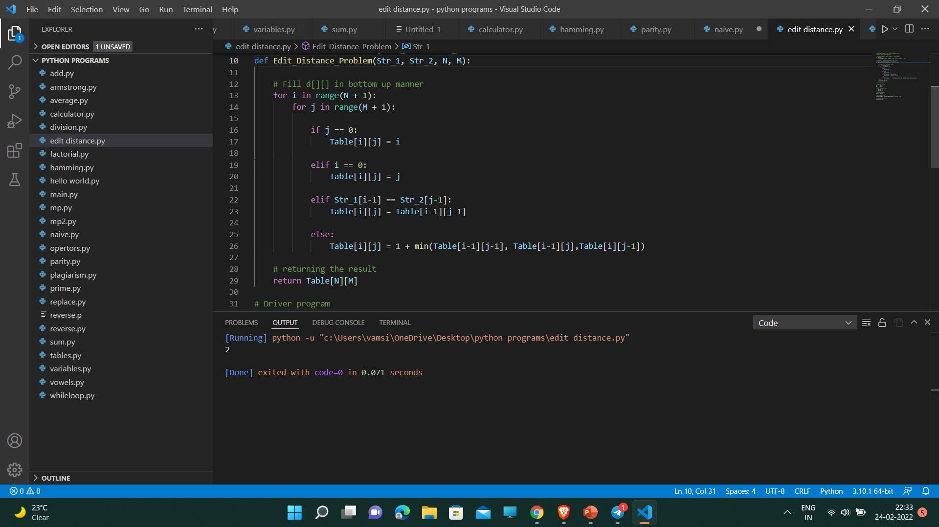
Output of the code

Slide 16

Github setup

